Slide 1
A Cloud Thermostat Controls the Earth’s Climate, Not Greenhouse gasses! Climate change is a myth!
John F. Clauser, retired experimental and theoretical physicist,
2022 Physics Nobel Laureate
817 Hawthorne Drive Walnut Creek, CA 94596,
email: bobbi_john@jfcbat.com, website: johnclauser.com

Slide 2
Introduction
The IPCC and its collaborators have been tasked with computer modeling and observationally measuring two very important numbers – the Earth’s so-called power imbalance and its power-balance feedback-stability strength.
Based on their interpretation of observational data and their computer modeling, the IPCC asserts with great confidence that there is more power IN than power OUT, and thus, the Earth is warming. In their 2021 AR6 report they assert that the net imbalance, power-IN minus power-OUT, is 0.7 ± 0.2 Watts per square meter of the Earth’s surface area.
The IPCC further asserts that this power imbalance is dominantly caused by the greenhouse gases, CO₂ and CH₄ , that are accumulating in the Earth’s atmosphere, and declares them to be “pollutants”. They exclude from their list, of course, the most powerful greenhouse gas of all, H₂O.
The IPCC asserts that greenhouse gas accumulation will lead to “climate change”, which, in turn, will lead to an apocalyptic increase in “extreme weather-related events” and other associated disasters.
The IPCC’s collaborator, the National Oceanographic and Atmospheric Association (NOAA), further asserts that the frequency of extreme weather related events has already been observed to increase in recent decades.
Additionally, IPCC and its contributors claim only marginal effectiveness for naturally occurring feedback mechanisms that presently stabilize the Earth’s temperature and climate.
They correspondingly assert that there is a “tipping point”, whereinafter further added greenhouse gasses catastrophically cause what amounts to a thermal-runaway of the Earth’s temperature.
The IPCC mandates that trillions of dollars must be spent to stop greenhouse gas release into the environment with a so-called “zero-carbon” policy.
The IPCC also mandates multi-trillion dollar per year geoengineering projects including Solar Radiation Management Systems to stabilize the Earth’s climate and CO₂ capture projects to reduce the atmospheric CO₂ levels.

Slide 3
A brief digression – What is the Earth’s so-called power imbalance?
The Earth’s power imbalance is the difference between its radiation power-IN and its power-OUT. More power-IN than power-OUT means that the Earth is warming.
A positive radiative power imbalance measured at the Top OF the Atmosphere is, in fact, the IPCC’s definition of “global warming”.
Power-IN is the sunlight power incident on the Earth. The IPCC and climate scientists call it Short Wavelength (SW) Radiation. It is about 340 Watts per square meter of the Earth’s surface area.
Power-OUT has two components:
One component is the sunlight energy that is directly reflected by the Earth back out into space, whereinafter it can no longer heat the planet. That component is claimed by the IPCC to be about 100 W/m².
The other component is the far-infrared heat radiated into space by a hot planet. It is claimed to be about 240 W/m². The IPCC calls the far-infrared heat radiation component, Long Wavelength (LW) Radiation.

Slide 4
I assert that the IPCC has incorrectly determined both of its most important numbers.
I show herein that the IPCC’s determination of the net power imbalance is badly wrong. It is computer modeled with incorrect physics. Its measurement data are badly fudged, in turn, to claim and that the Earth is warming and that there is a climate crisis, when, in fact, there is no climate crisis.
Based on their interpretation of observational data and computer modeling, the IPCC’s 2021 AR6 report’s power-flow diagram (p.934) claims, with great confidence, that the power imbalance is precisely 0.7 ± 0.2 W/m².
Note that this claimed imbalance is very small - only about 0.2% of power-IN. Nonetheless, the IPCC very confidently asserts that there is more power IN than power OUT, and thus the Earth is warming.
Unfortunately, that same diagram, itself, displays, on its face, an arithmetical “miscalculation” (I call it a fudge) that instead evaluates as 2.5 ± 2.9 W/m², with the same “great confidence”. Similar arithmetical “miscalculations” (fudges) occur on many of the IPCC’s contributors reports, as I expose in this talk. The data are clearly fudged!
The various measurement modalities are also in wild disagreement with each other regarding the measured imbalance by typically about 10 W/m². Strong disagreement is rampant among the investigators over the source of the measurement disagreement. So much for “high confidence” in the accuracy of the data. Moreover, most investigators argue that it is impossible to measure the Earth’s power imbalance to the desired accuracy (± 0.1 W/m²).

Slide 5
My contribution to the puzzle – the cloud feedback mechanism. There is no climate crisis.
Importantly, the power imbalance is actually observed to be continuously wildly fluctuating by anywhere between 18 to 55 W/m². Its fluctuation range is between 5 to 16% of power-IN. This fact alone makes its required precision measurement (to .03% of power-IN) effectively impossible.
I assert that this seemingly random fluctuation of the power imbalance is not random at all, but is actually a crucial part of a thermostat-like feedback mechanism that controls and stabilizes the Earth’s climate and temperature. Just like the thermostat in your home, the power-imbalance is never zero. The furnace or AC is always either ON or OFF. The thermostat simply modulates the heating/cooling duty cycle.
The IPCC’s 2021 AR6 report (p.978) claims that climate stabilizing natural feedback mechanisms have a net stabilizing strength of -1.16 ± 0.6 W/m²/K.
I introduce my cloud feedback mechanism that has a net stabilizing strength of anywhere between -5.7 to -12.7 W/m²/K, depending of one’s assumptions regarding the albedo of clouds.
I correspondingly assert that both of the IPCC’s quantitative claims of global warming are dead wrong.
My cloud thermostat mechanism provides nature’s own Solar Radiation Management System. This mechanism already exists. It is built in to nature’s own cloud factory. It works very well to stabilize the Earth’s temperature on a long term basis. And, it is free!
There is no climate crisis! The IPCC’s claims are simply bad science.
The IPCC’s mandates for spending trillions of dollars represent a colossal hoax and are a total waste of money!

Slide 6
In this talk I show that the IPCC’s claims are a hoax. Their claims are based on flawed computer modeling, on bad science, and on dishonest data fudging
The IPCC’s computer-modeling is grossly flawed and does not get anywhere near in accounting for past climate behavior. It is correspondingly totally unreliable in predicting future climate behavior. The quantitative simulations of the sunlight power reflected back into space are grossly wrong. Something is obviously very wrong with the physics incorporated within the computer models. This fact was earlier pointed out by physicist Steve Koonin in a recent book. I herein describe additional important deficiencies of the models.
So much for theory. What about experiment? Measuring the power imbalance consists of measuring power-IN, measuring power-OUT and subtracting. Simple enough? Not really. The problem is that power-IN, and power-OUT are huge numbers, and that the difference between them is miniscule (0.2% of power-IN). That miniscule difference is the net imbalance that is sought, both experimentally and theoretically. Unfortunately, it is so small that it is very difficult, if not impossible, to measure. It is much tougher to measure when power-IN and power-OUT are hugely varying in a seemingly random irreproducible fashion, both in time and in space over the surface of the Earth.
I will show that this huge fluctuation, is in fact, a major asset to the real process that controls the Earth’s climate.
A variety of methods has been employed to measure these powers. They include satellite radiometry, (the ERBE, and CERES Terra and Aqua satellites), ocean heat content (OHC) measured using the ARGO buoy chain and XBT water sampling by ships, and finally by ground sunlight observations using the Baseline Surface Radiation Network (BSRN).
The various measured values are all in wild disagreement with each other. Importantly, none of the reported data actually show a convincing net warming power imbalance. Importantly, much of the reported data are totally fudged in a manner that dishonestly changes them from showing no warming to showing warming!
NOAA’s own presented data disprove their claims that the frequency of extreme weather events is increasing.

Slide 7
In this talk I also introduce the cloud-thermostat mechanism. It uses correct physics.
I show that the cloud-thermostat provides the dominant mechanism that is controlling the Earth’s climate.
I further show that the cloud-thermostat mechanism provides very powerful feedback that stabilizes the Earth’s climate and temperature. It great strength obtains from the observed large fluctuation of the Earth’s power imbalance.
In preparation for the introduction of this model, I describe important, underappreciated, but conspicuous properties of clouds - their variability and their strong reflectivity of sunlight (SW radiation).
I show that the cloud-thermostat mechanism involves the dominant use of sunlight energy by the planet.
Via the cloud-thermostat mechanism, clouds modulate the outgoing Shortwave power and therefore control the Earth’s power imbalance, minimally with a 18 W/m² available power range, which is minimally 26 times the IPCC’s 0.7 W/m² claimed power imbalance, and 45 times the IPCC’s ± 0.2 W/m² power imbalance two-sigma error range.
The above numbers use the IPCC’s assumed data parameters. With more realistic assumptions, the cloud-thermostat mechanism controls the Earth’s power imbalance with a 77 W/m² available power range, which is 110 times bigger than the IPCC’s 0.7 W/m² claimed power imbalance, and 770 times bigger than the IPCC’s ± 0.1 W/m² one-sigma power-imbalance error range.
I show that when the cloud-thermostat mechanism is viewed as a form of climate-stabilizing negative feedback, it is by far the most powerful of any such mechanism heretofore considered.
The IPCC estimates that the net stabilizing feedback strength or the Earth’s climate, including the destabilizing feedback strength of greenhouses is about -1 W/m²/ºC.
I show that the cloud thermostat feedback increases the net natural stabilizing feedback strength to about anywhere between -7 W/m²/ºC and -14 W/m²/ºC, depending on the assumptions used.

Slide 8
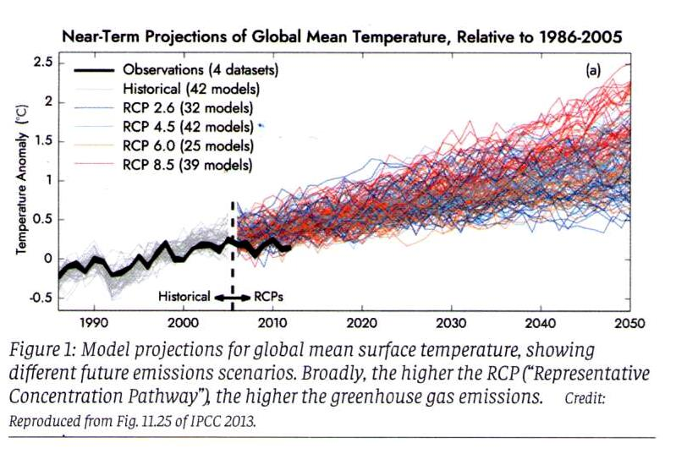
The IPCC’s AR5 2013 report uses the various CMIP5 computer model results. They evidence huge disparities among themselves in their predictions. The also do not agree with past-temperature measurements.
This graph is from the IPCC’s IPCC’s AR5 (2013) report. It shows the “temperature anomaly”, as a function of year as calculated by using more than 40 different CMIP5 computer models, authored by the Goddard Institute for Space Studies. For comparison, the solid black line shows the observed temperature for 1985 – 2010. It shows, in fact, that the temperature had leveled off, and was not rising in 2010, contrary to news reports at that time.
The various computed curves display the earth’s predicted (colored) and historical (gray) “temperature anomaly”.
The models’ various authors (at GISS), themselves, demonstrate a total lack of “scientific consensus”, as is exhibited by their disparate predictions and historical simulation capabilities.
The total disarray and total lack of reliability among the CMIP5 predictions was first highlighted by Steve Koonin (former White House science advisor to Barak Obama) in his recent book- Unsettled? What climate science tells us, what it doesn’t, and why it matters.
Something is obviously very wrong with the physics incorporated within the computer models.
Figure copied from the IPCC’s IPCC’s AR5 (2013) Figure 11.25, and from N. Jeevannjee, APS News (2023).

Slide 9
Another brief digression - what is albedo?
Recall that Outgoing ShortWave (reflected sunlight) power (claimed to be about 100 W/m²) is one of three big numbers involved in calculating the Earth’s power imbalance.
The term albedo is commonly used as a convenient non-dimensional shorthand measure of this reflected sunlight power.
The Earth’s albedo is its fractional reflectivity of sunlight power by the Earth.
The Earth’s albedo is the Outgoing ShortWave (reflected) power, divided by the Earth’s Incident ShortWave power (claimed about 100/340 ≈ 0.3).

Slide 10
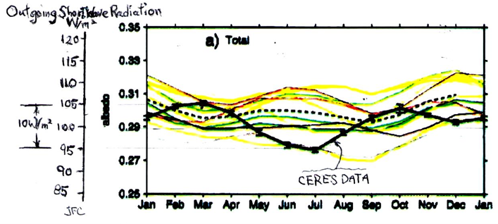
The Earth’s global spatial average albedo and Outgoing ShortWave power (reflected sunlight) are strongly temporally varying and grossly incorrectly computer modelled.
The added scale shows the Outgoing ShortWave (reflected sunlight) power, assuming a constant sunlight input power (340 W/m²).
The Outgoing power is shown to be fluctuating (non-sinusoidally) on the added scale by about 10 W/m².
However, the actual total variation of the global average Outgoing ShortWave power is actually about ± 16 W/m² when the (± 5 W/m²) additional annual variation of solar power input is included.
IPCC reports ignore these huge variations of Outgoing and Incoming SW power.
The IPCC also claims that it has measured the power imbalance precisely to be within ± 0.1 W/m² (one-sigma) in the presence of this huge fluctuation (about the width of the black curve line, itself). I am skeptical!
This Figure is from Stephens et al. (2015, Fig 11a). It shows the global spatial mean non-sinusoidal annual cycle of the Earth’s (all-sky) Top of Atmosphere albedo, plotted versus.
The solid black line shows CERES (Terra and Aqua) satellite measurements of the Earth’s albedo.
The various colored curves are the CMIP5 computer simulations.
The computer simulations don’t get anywhere near agreement with the measured data.
Something is obviously very wrong with the physics incorporated within the CMIP5 computer models.

Slide 11
Measuring the Earth’s energy imbalance is very difficult! It is a very small difference between some very big and continuously, fluctuating numbers.
The IPCC’s sacred quest is to accurately determine the precise value of the energy imbalance.
Getting it right is worth trillions of dollars.
I will now show that the observational data, in fact, do not actually show a net warming energy imbalance!
The investigators, themselves, actually admit that the employed measurement modalities are incapable of measuring the imbalance with the required accuracy and spatial resolution
But the IPCC and its contributors’ reports are nonetheless fudged to fraudulently claim that there is an observed net warming.

Slide 12
What is the basic power-imbalance calculation? It is really quite simple.
The three needed numbers are readily available from the top of a power-balance study’s power-flow diagram. If you don’t believe my claims of fudging, it’s easy enough to freely download the articles, pull the numbers from the various power-flow diagrams, and do the summations yourself!
A typical calculation is as follows:
Incident ShortWave power +340 W/m² ± σ_{IN}
Outgoing ShortWave reflected power -100 W/m² ± σ_{SW-OUT}
Outgoing LongWave reemitted power -240 W/m² ± σ_{LW-OUT}
Sum=Net “observed” power imbalance IMBALANCE ± σ_{IMBALANCE}
σ_{IMBALANCE} = (σ_{IN}² + σ_{SW-OUT}² + σ_{LW-OUT}²)^{1/2}. (RMS sum)
Note: σ_{IMBALANCE} > σ_{IN}, σ_{IMBALANCE} > σ_{SW-OUT}, σ_{IMBALANCE} > σ_{LW-OUT}.
IMBALANCE = no global cooling if < - σ_{IMBALANCE},
global warming if > + σ_{IMBALANCE.}

Slide 13
The earliest data are reported by Stephen’s et al. (1981) and Ramanathan (1987).
Their results are based on based on only four partially analyzed months of observation by the ERBE satellite – (Apr. 1985, July 1985, Oct. 1985, Jan. 1986).
Their resulting Top of Atmosphere net power imbalance results are as follows:
Stephens Ramanathan
et al. (1981) (1987)
Incident ShortWave power (W/m²) +344 +340
Outgoing ShortWave power -103.2 -106
Outgoing LongWave power -234±7 -237
Net “observed” power imbalance +9 ± 10 0
jfc calc +6.8
Both Stephens et al. and Ramanathan’s data are fully consistent with zero net global warming and/or cooling.
The 2003 US National Academy / National Research Council report “Understanding Climate Change Feedbacks” cites Ramanathan (1987), and comments (p.112) that “The observations do not meet quality standards.”

Slide 14
Loeb et al. (2009, 2012) use OHC data to “adjust” Ramanathan’s (1987) numbers, to show a net warming power imbalance.
Loeb et al. (2012, p.111) admit ”A limitation of the satellite data is their inability to provide an absolute measure of the net TOA radiation imbalance to the required accuracy level.”
Loeb et al. (2009, 2012) arbitrarily replace Ramanathan (1987)’s (very sparsely sampled) EREB satellite data with new values that now show a net global warming power imbalance.
They obtain their new preferred data values by switching modality from satellite-radiometry data to ocean heat content (OHC) data (also very sparsely sampled) from the ARGO buoy chain, and from XBT ship-based bathythermograph manually sampled water temperature data.
They base their action on a claimed increase in ocean heat content, and on speculation by Hansen et al, (2005, 2011).
Their resulting Top of Atmosphere net power imbalance results:
EREB OHC (2009) OHC (2012)
Incident ShortWave power (W/m²) +340 +340 +340
Outgoing ShortWave power -107 -99.5 various
Outgoing LongWave power -234.6 -239.6 ________
net power imbalance -1.6 + 0.9 +0.64 ± 0.11
(cooling) (warming) (warming)
Unfortunately, the ARGO and XBT data have a woefully sparse area sampling, and much worse accuracy than Loeb et al. claim. Data gaps are filled using totally fabricated data by Lyman and Johnson (2008). (Data fabrication is one of our scientific little no-no’s.)

Slide 15
Power imbalance analysis by Stephens et al. (2012) with grossly admittedly-fudged error estimates
Following Loeb et al., Stephens et al. (2012) also admit that satellite data are unable to observe a net imbalance! The groups join forces and all switch to the use of Ocean Heat Content (OHC) data.
Stephens et al. (2012) use OHC data and the Outgoing ShortWave power “adjustment” (fudge!) reported earlier by Loeb et al. (2009, 2012) to claim a net global-warming power imbalance:
Incident ShortWave power (W/m²) +340.2 ± 0.1
Outgoing ShortWave power -100.0 ± 2.0
Outgoing LongWave power -239.7 ± 3.3
Net “claimed observed” power imbalance +0.6 ± 0.4 ← remember these #’s
(fudged warming)
Actual summation & assoc. RMS error (jfc) +0.5 ± 3.9
(no warming)
Stephens et al.’s use of (visibly) incorrect arithmetic is yet another one of our scientific little no-no’s.

Slide 16
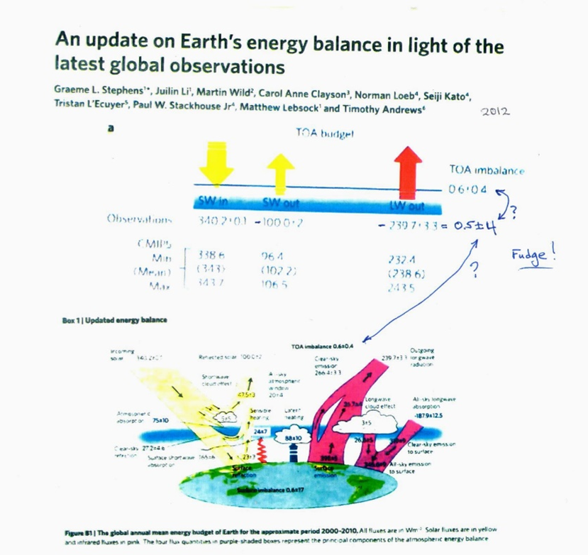
Stephens et al. (2012) power-flow diagrams show the fudged numbers
Figures 1 and B1 from Stephens et al. (2012)

Slide 17
L’Ecuyer et al. (2015) reanalyze the Ocean Heat Content (OHC) data and get different results and much larger error estimates than reported by Stephens et al. (2012)
Following the Stephens et al. (2012) estimate of the Earth’s power imbalance based on OHC data, L’Ecuyer et al. (2015) revise Loeb et al.’s (2009, 2012) ocean heat content data analysis.
They correspondingly revise upwardly the (fudged) power imbalance error limits offered by Stephens et al. (2012). They do, however, provide their own “adjustments”, that they instead call constraints.
unconstrained constrained
Incident ShortWave power (W/m²) +340.0 ± 0.5 +340.2 ± 0.1
Outgoing ShortWave power -102 ± 4 -102 ± 4
Outgoing LongWave power -238 ± 3 -238 ± 2
Net “observed” power imbalance 0 ± 5.0 0 ± 3.5
(no warming) (no warming)

Slide 18
Power flow diagram from L’Ecuyer et al. (2015, Fig.1.)

Slide 19
Critiques by Trenberth et al. (2010, 2014)
Satellites measure the Top of Atmosphere energy balance, while Ocean Heat Content data apply to the surface energy balance. One may legitimately mix power-flux data at the two different altitudes, if and only if one fully understands all of the power-flow processes in the atmosphere that occur between the surface and the Top of Atmosphere. If the latter requirement is not true, then one ends up with an “apples to oranges” comparison.
Trenberth et al. (2010, 2014) are highly critical of Loeb, Stephens, L’Ecuyer, and Hansen’s claimed understanding of the associated connection between the power flows at these two altitudes.
Trenberth and Fasullo (2010) point to a huge “missing energy” indicated by the difference between the satellite data and the OHC data imbalance calculations, and wonder “Where exactly does the energy go?”
Hansen et al. (2011) dismiss the alleged missing energy as being due to satellite calibration errors.
Trenberth Fasullo and Balmesada (2014) further note that despite various considerations of the surface power balance, significant unresolved discrepancies remain, and they are skeptical of the power imbalance claims.
In effect, Trenberth et al. are the earliest “whistle blowers” to the above-mentioned data fudges.

Slide 20
Stephens and L’Ecuyer (2015) together offer a mea culpa admission to having made an “unjustified, ad hoc” choice between OHC data and CERES satellite data, and miraculously now claim simultaneously both zero and +0.6 +/- 0.4 W/m² power imbalance.
In response to criticism by Trenberth et al. (2010, 2014), Stephens and L’Ecuyer (2015) together offer what amounts to a mea culpa article regarding the aforementioned data fudging. They admit that “adjustments” do need to be made to obtain agreement (closure) between satellite data and ocean heat content data, and that these “adjustments” are very much larger (about 10 W/m²) than their claimed power imbalance, +0.6 +/- 0.4 W/m².
Stephens and L’Ecuyer (2015) also admit that their choice of which data needs “adjustment” was made “in a totally ad hoc” fashion, and that “there is no real evidence to support one adjustment approach over the other”.
Amazingly, however, Stephens and L’Ecuyer (2015) still report that the power imbalance 0.6 +/- 0.4 W/m2 (= global warming).
OHC CERES (satellites)
Incident ShortWave power (W/m²) +340.0 ± 0.1 +340.0 ± 0.1
Outgoing ShortWave power -102 ± 4 -100 ± 4
Outgoing LongWave power -238 ± 4 -240 ± 4
Power imbalance reported in abstract line 5 +0.6 +/- 0.4 W/m²
(warming)
Net “calculated” power imbalances (jfc) 0 ± 5.6 0 ± 5.6
(no warming) (no warming)

Slide 21
Power imbalance analysis by Wild et al. (2019) and AR6 (2021) – error bars still fudged.
Wild et al. (2019) report new Clear sky (cloud-free-sky) measurements to the data set using ground sunlight observations via the Baseline Surface Radiation Network (BSRN).
The Wild et al. (2019) results are used directly by AR6 (2021), except for added fudges. The power fluxes and error bounds presented are copied directly from the top lines of their nearly identical power-flow diagrams. The fudged power imbalances are copied directly from the associated lower left-hand corners.
Wild et al. AR6
(2019) (2021)
Incident ShortWave power (W/m²) +340.5 ± 0.5 +340.0 ± 0.5
Outgoing ShortWave power -98 ± 2 -98.5 ± 1.5
Outgoing LongWave power -239 ± 3 -239.5 ± 2.5
Power imbalance reported at bottom +0.6 +/- 0.4 +0.7 ± 0.2
(lower left hand corner of Figures) (warming) (strong warming)
Net “calculated” power imbalance (jfc) 3.5 ± 3.6 2.5 ± 2.9
(no warming) (no warming)
The arithmetically incorrect fudged numbers shown in red are the values reported at bottom of their power flow diagrams. The last line gives the correct summation.

Slide 22
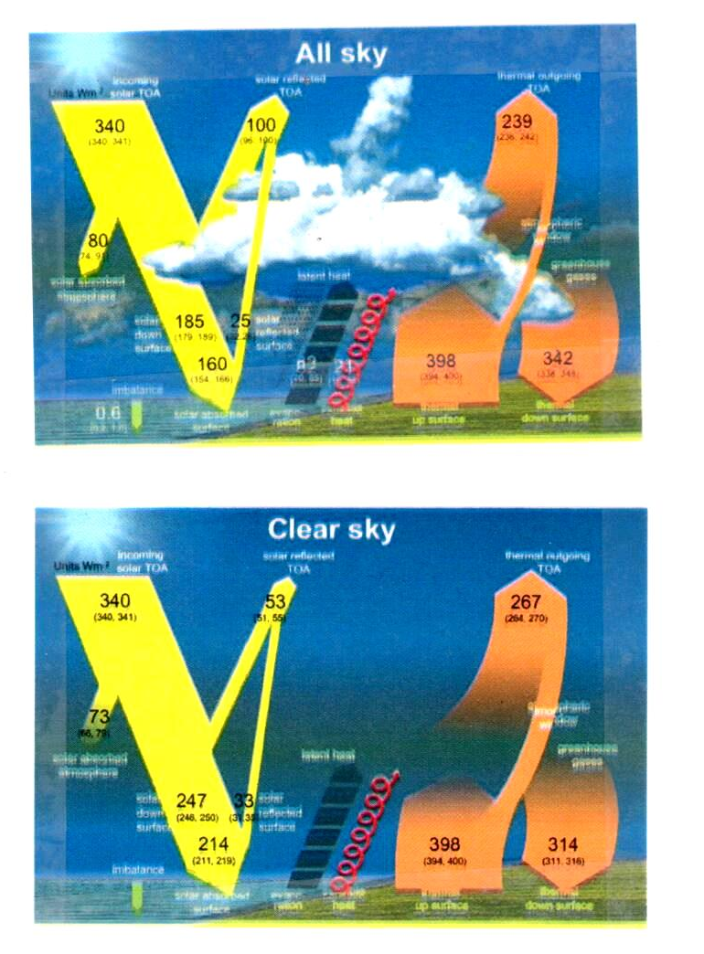
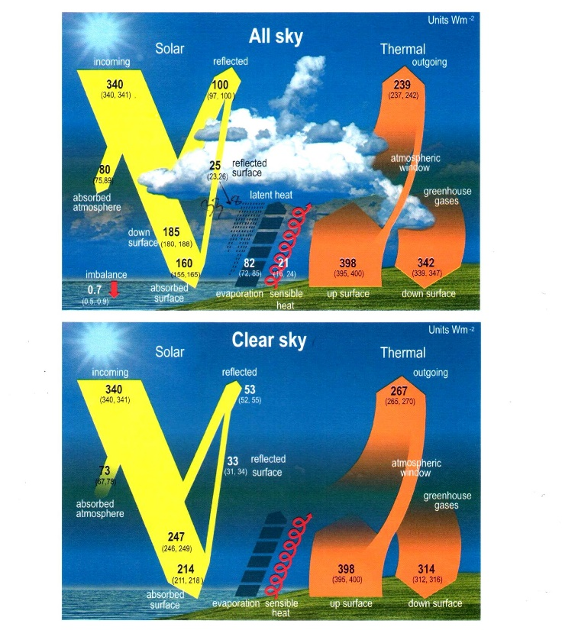
Wild (2019, left pair) & AR6 (2021, p.934), right pair) power-flow diagrams.

Slide 23
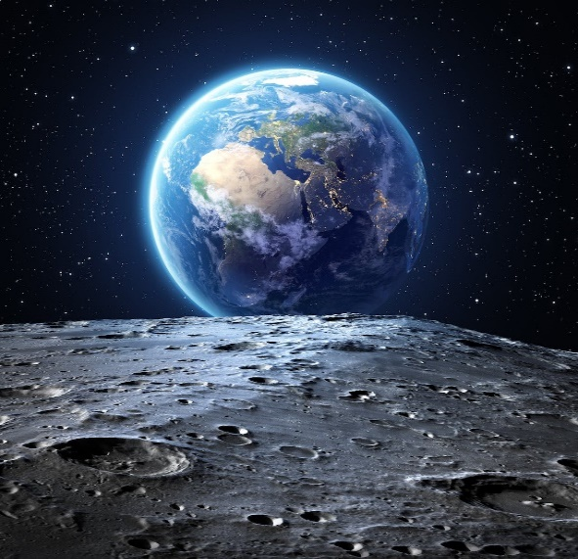
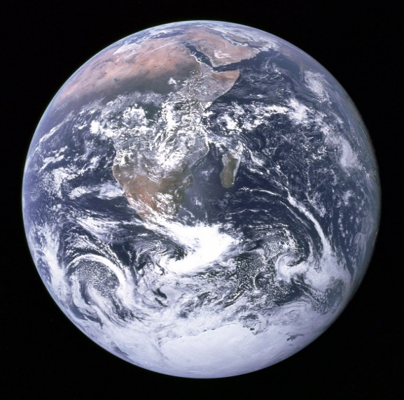
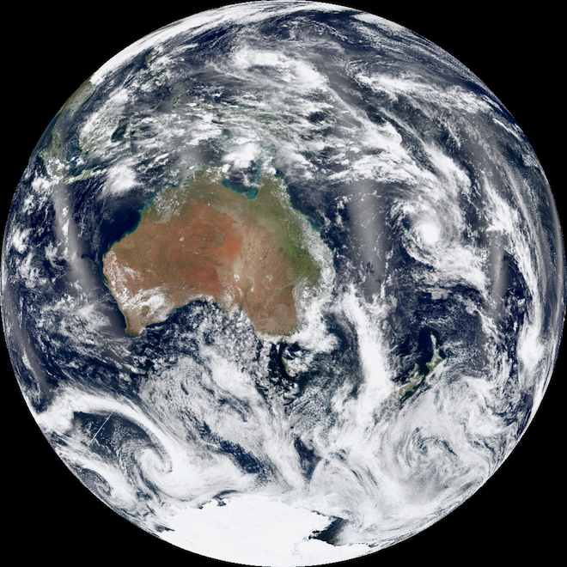
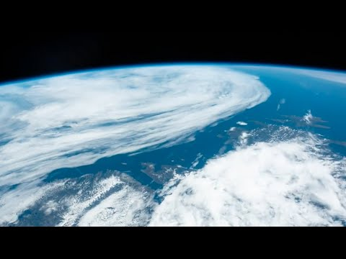
IV. Some important properties of clouds
What does the Earth look like when viewed from space in sunlight?

Slide 24
There are 5 important take-home messages to be gleaned from these satellite photographs.
Clouds reflect dramatically more sunlight than the rest of the planet does!
Clouds of all types appear bright white!
The photos (along with a large number of careful measurements) strongly suggest that the average cloud- reflectivity (of sunlight) is about 0.8 – 0.9. (For comparison, white paper has a reflectivity of ≈ 0.99.)
The rest of the planet appears much darker than the clouds. The average reflectivity of land (green and brown areas) and ocean (dark blue areas) is ≈ 0.16.
Cloud coverage area is highly variable over the Earth.

Slide 25
Clouds cast dark shadows
Clouds cast dark sharply-defined shadows on the surface below them. Just stand on a hillside on a partly cloudy day and watch the cloud shadows pass over the land below.
Watch your solar-panel output when a solitary cloud passes in front of the sun. Typically, the output drops to 50% or less.
Try reading a book indoors on a heavily overcast day without turning on the lights. You can’t. It’s too dark. Where did all of the missing sunlight go? Since water droplets negligibly absorb sunlight, the missing sunlight (typically 80-90% of it) got reflected back out into space.

Slide 26
What does sunlight mostly do when it reaches the Earth’s surface?
It is commonly believed that sunlight that is absorbed by the Earth’s surface simply warms the surface. That may be true over land. But land represents only about 30% of the surface.
Oceans cover 70% of the Earth’s surface. Correspondingly, about 70% of incoming sunlight falls on the oceans.
Following the AR6 power-flow diagram, 160 W/m² is absorbed by the whole Earth, meaning that roughly 70% X 160 = 112 W/m² is absorbed by oceans.
The AR6 power-flow diagram indicates that 82 W/m² is used for evaporating water, and not for heating the surface.
Since clouds are mostly produced over the oceans (because that’s where the exposed water is), then 82/112 = 73% of the input energy absorbed by the Earth’s oceans is used, not for warming the Earth, but instead simply for making clouds.

Slide 27
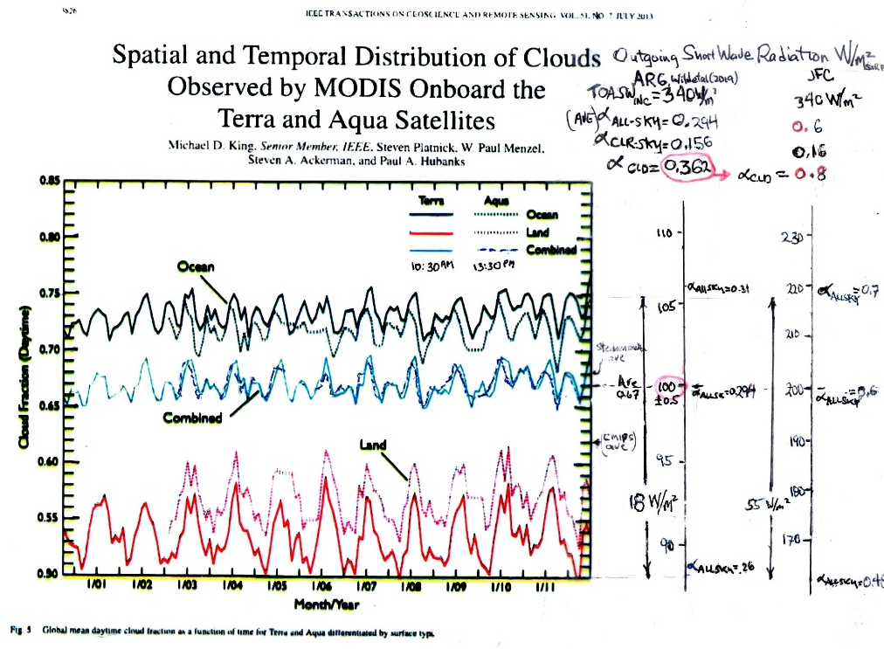
Satellite observations of cloud-cover fraction by King et al. (2013).
King et al. (2013) analyzed more than 12 years of data from the CERES Terra and Aqua sun-synchronous satellites, and measured the daytime fractional cloud cover, over ocean, land, and combined.
I have added Outgoing (reflected sunlight) SW power scales, assuming a solar input power , 340 W/m².
The left-hand scale uses the parameters from the 2021 AR6 report. It thus assumes an all-sky albedo = 0.3, and a clear-sky albedo = 0.16. Energy conservation further requires a cloudy-sky reflectivity (albedo) = 0.36. (an unreasonable value). On this scale, reflected SW power fluctuates by as much as 18 W/m².
The right-hand scale uses the same parameters, except that it assumes a cloudy-sky albedo = 0.8, as per the cloud photos and various measurements. Reflected SW power then fluctuates by as much as 55 W/m².
For comparison, recall that the IPCC insists that the global average power imbalance is always precisely 0.7 ± 0.1 W/m² (one-sigma error).
The albedo fluctuation data presented by Stephens et al. (2015, earlier slide), compared to this Figure, shows that the albedo fluctuation is due to cloud-cover fraction variation.
Conclusion: Cloud-fraction variation, especially for clouds passing from ocean to land, strongly modulates the Outgoing sunlight power, and strongly affects the power imbalance.

Slide 28
My cloud thermostat model – how does it work?
Recall that the IPCC’s AR6 power-flow map asserts that 73% of the input energy absorbed by the Earth’s oceans is used, not for warming the Earth, but instead simply for evaporating seawater and making clouds, rather than for raising the Earth’s surface temperature. Recall that the Earth has a strongly varying cloud cover and albedo.
Temperature control of the Earth’s surface by this mechanism works exactly the same way as does a common home thermostat. A thermostat automatically corrects a structure’s temperature in the presence of varying modest heat leaks. For the earth, the presence of significant CO₂ in the earth’s atmosphere, manmade or not, provides, in fact, a very small heat leak. Note that, jusl like the Earth, the power imbalance is never zero. It is always fully heating or fully cooling.
How does the cloud thermostat it work? When the Earth’s cloud-cover fraction is too high, then the earth’s surface temperature is too low. Why? Clouds produce shadows. Cloudy days are cooler than sunny days. A high cloud-cover fraction equals a highly shadowed area. Remember that when trying to read a book indoors on an overcast day, there is not much sunlight. With reduced sunlight reaching the ocean’s surface and lower temperature, the evaporation rate of seawater is reduced. The cloud production rate over ocean (70% of the earth) is low because sunlight is needed to evaporate seawater. The earth’s too-high cloud-cover fraction obediently starts to decrease. Very quickly, cloud-cover fraction decreases, the temperature increases. The Earth’s cloud-cover fraction is no longer too high. Equilibrium cloud cover and temperature are restored.
When the Earth’s cloud-cover fraction is too low, the surface temperature is then too high, then the reverse process occurs. With low cloud cover, lots of sunlight reaches the ocean surface. Increased sunlit area then evaporates more seawater. The cloud-production rate obediently increases and is no longer too high . Equilibrium cloud cover is again restored.
Depending of one’s assumption regarding cloud reflectivity (albedo), the cloud thermostat mechanism has anywhere between 18 and 55 W/m² power available from cloud-fraction variability to overcome a wimpy 0.7 W/m² heat leak (allegedly blamed on greenhouse gasses) and to stabilize the Earth’s temperature, no matter what the greenhouse gas atmospheric concentration is!
These two fluctuating opposing processes, when in equilibrium, provide an equilibrium cloud-cover fraction, and an equilibrium average temperature. The earth thus has a built in thermostat!

Slide 29
Analysis of atmospheric feedback systems
The IPCC’s second sacred task was to estimate the so-called feedback stability of the Earth’s atmosphere and its sensitivity to external perturbations, such as increased greenhouse gasses, volcanism, etc.
Given huge observed fluctuations in Outgoing power, the Earth obviously maintains a surprisingly stable long-term temperature.
Climate scientists have surmised the existence of a variety of feedback mechanisms that account for its evident stability.
Climate feedback systems are discussed extensively by the 2003 National Research Council / National Academy report “Understanding Climate Change Feedbacks”, by Sherwood et al. (2020 – the Ringsberg Castle study), and by AR6 (2021, Chapter 7.4).
I will follow the detailed methodology used by Sherwood et al. (2020), except that I will remove one of their overly restrictive assumptions.
Viewed as a temperature-control feedback mechanism, the cloud thermostat has the strongest negative (stabilizing) feedback of any mechanism heretofore considered, as I now show.

Slide 30
Climate feedback, as per Sherwood et al. (2020)
Sherwood et al. use the symbol ΔN, to represent the downward-flowing energy imbalance, calculated at the Top of Atmosphere. This is the commonly fudged quantity the I have discussed above. It is the primary target of the IPCC’s computer modelling and observational efforts.
If the imbalance, ΔN, is negative, the earth is cooling. If it is positive, the Earth is warming.
For any given feedback mechanism, Sherwood et al. (2020) calculate the overall feedback strength (sensitivity) as the derivative of ΔN with respect to the Earth’s surface temperature,
λ ≡ dΔN / dT_{Surface}.
If λ is negative, the feedback stabilizes the system. If , if λ is positive, the system is unstable.
If the system has a variety of independent mechanisms, and each mechanism, labeled j, relies on an associated intermediate variable, x_{j} , then the total system’s feedback strength is calculated using the chain rule for derivatives, as per
λ ≡ Σ_{j} λ_{j} = Σ_{j} (∂ΔN /∂x_{j}) X (∂x_{j}/∂T_{Surface}).
(For some strange reason, Sherwood et al. (2020) arbitrarily structure the allowable forms for ΔN to prohibit the use of f_{Clouds} as an intermediate variable x_{Clouds} .)
For example, the primary temperature stabilizing feedback mechanism is via the Stefan-Boltzmann law’s σT⁴ dependence of far-infrared (LW) energy reemission by the Earth. Here, σ, is the Stephan-Boltzmann constant. Sherwood et al. (2020, p.19) calculate the (misnamed) feedback parameter, λ_{Planck}, for Stefan-Boltzmann law negative feedback, as λ_{Planck} = -3.3 W/m²/K.
(The Stefan-Boltzmann Law was discovered in 1879. Planck’s law was not discovered until 1900. The quantity called λ_{Planck} should properly be called λ_{Stefan-Boltzmann}.)

Slide 31
Strength of the cloud thermostat feedback mechanism
To calculate the feedback strength for the cloud thermostat, note that the shadowing of the oceans by clouds modulates the the sunlight irradiance reaching the surface, SW_{down}. Using the albedo conservation theorem and the terminology introduced in Appendix A, it is given by
SW_{down} ≡ (1-α_{ALL-sky}) TOA_{INC}
= [1–(f_{Clouds} α_{Clouds} + f_{CLR-sky} α_{CLR-sky})] TOA_{INC},
where TOA_{INC} is the incident sunlight power.
The climate feedback parameter for the specific cloud thermostat process,
λ_{Clouds} ≡ d SW_{down} / dT_{surface},
may be expanded using the chain rule, and f_{Clouds} as an intermediate variable, as
λ_{Clouds} = d SW_{down} /dT_{surface} = (∂ SW_{down} /∂ f_{Clouds}) X (∂ SW_{down} /∂T_{surface})
= – (f_{Clouds} α_{Clouds}) TOA_{INC} (∂ f_{Clouds} /∂T_{surface}).

Slide 32
One may reasonably estimate the important parameter, ∂f_{Clouds}/∂T_{surface} ≈ 0.07/K, by noting that both the precipitation rate of clouds and the evaporation rate are a sensitive function of surface temperature, that in turn, is directly proportional to the vapor pressure of seawater, whose temperature dependence is about 8% per degree Kelvin (or Celsius).
The resulting cloud-thermostat feedback parameter is now readily evaluated under the two scenarios associated with two choices for cloud albedo :
Using the AR6 choice for cloud albedo, α_{Clouds} = 0.36, we have λ_{Clouds} ≈ - 5.7 W/m² K, which 1.7 times larger than (the misnamed) λ_{Planck} , heretofore the strongest feedback term.
Alternatively, using the more reasonable choice for cloud albedo, α_{Clouds} = 0.8, we have λ_{Clouds} ≈ -12.7 W/m² K, which is 3.8 times larger than (the misnamed) λ_{Planck}. In either scenario, the cloud-thermostat feedback is the strongest feedback mechanism controlling and stabilizing the Earth’s climate and temperature.
These values are plotted on an extension of the AR6 Figure 7.1, which shows the feedback strength for various mechanism. The total system strength is the left-hand column.

Slide 33
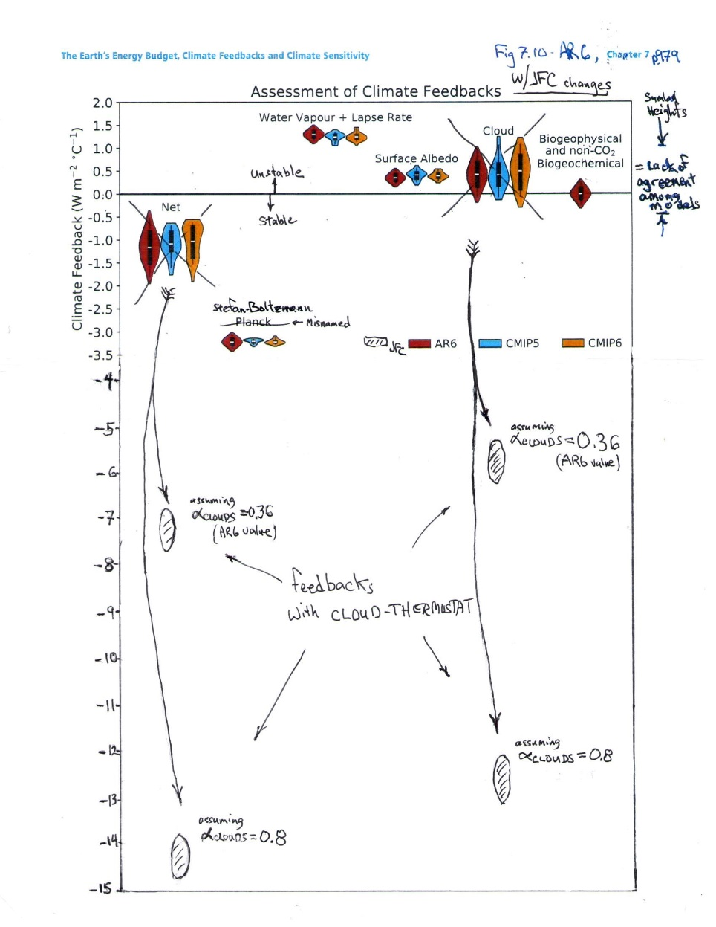
Comparative feedback sensitivities for various mechanisms.
AR6 (2021, Fig. 7.10, p. 979) estimates for the so-called feedback strengths (sensitivities) for various mechanisms.
The AR6 Figure is modified by replacing their estimate of λ_{Clouds} , with the estimates calculated here for the cloud-feedback mechanism, under two scenarios - assuming cloud albedo = 0.36, and 0.8. In both scenarios, the cloud-feedback mechanism is dominant.

Slide 34
NOAA’s scientific disinformation hoax asserting that the frequency of extreme weather events is increasing
2012, Physics Today article “Predicting and Managing Extreme Weather Events” – Earth’s climate is warming, and destructive weather is growing more prevalent. Coping with the changes will require collaborative science, forward-thinking policy, and an informed public.”
Authors: Jane Lubchenco, undersecretary for oceans and atmosphere at the US Dept. of Commerce, and NOAA administrator, and Thomas Karl, Director of NOAA’s climatic data center and chair of the US Global Change Program.

Slide 35
NOAA’s disinformation hoax regarding an impending climate apocalypse
The article asserts that there is an increase in the extreme weather event frequency that is associated with climate change in the three decades ending in 2012.
The article presents data in their Fig. 2a displaying NOAA’s Weather and Climate Extremes Index. That index is NOAA’s numerical composite measure of the frequency of so-called extreme weather events, including hot-spells, cold-spells, droughts, floods, land-falling hurricanes, etc. (EF3+ tornado frequency is conspicuously absent from the list, presumably because it was actually decreasing. See Koonin, pp.124-125)
The authors assert that their climate extremes index has “obviously” grown steadily over the last three decades. I assert here that their own data in their Fig. 2a disprove their own assertion.

Slide 36
Lubchenco and Karl’s Fig. 2a

Slide 37
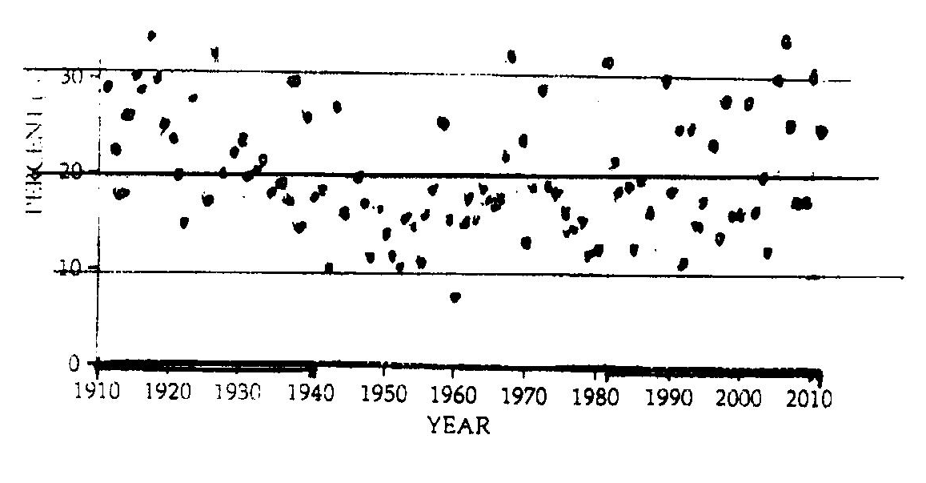
The two graphs below are traced directly from Fig. 2a. They are identical, except that one is plotted left-to-right reversed, i.e. backwards with time increasing to the left. If you look carefully, you will see that they are mirror images. If you can’t tell which one of these graphs is correctly plotted and matches the one on the previous slide, and which one is time-backwards, I assert that their claimed recent increase in extreme weather-event frequency is not obviously indicated by their data, as they claim. Their claim is false! Are you really confidently willing to bet trillions of dollars that you can tell which one is correct? These data portend the impending apocalypse, so Lubchenko and Karl claim.

Slide 38
Conclusions
The IPCC and its contributors claim the Earth has a net-warming energy imbalance. I show here that those claims are false.
The IPCC bases its claims on computer modeling of the Earth’s atmosphere, and on observational data from a variety of observational modalities. Both the computer models and the observational data are flawed.
The IPCC’s computer modeling and its predictions are totally unreliable. There is something clearly very wrong with the physics incorporated within these computer models. Since the computer models can’t even explain the past, why should anyone trust their prediction for the future?
Not one of the observational modalities for measuring the Earth’s power imbalance convincingly shows net global warming.
The IPCC and NOAA further claim that the purported power imbalance has already caused an increase in dangerous extreme weather events. NOAA’s own data disprove their own claims.
I show where various observers and the IPCC have dishonestly fudged their reported data, and have dishonestly changed it from showing No Warming, to showing Warming. Crucially important data fudges are revealed here and highlighted in red.
I introduce the cloud-thermostat mechanism.
The cloud thermostat is clearly the overwhelmingly dominant climate controlling feedback mechanism that controls stabilizes the Earth’s climate and temperature. It thereby prevents global warming and climate change.
I thus offer Great News. Despite what you may have heard from the IPCC and others, there is no real climate crisis! The planet is NOT in peril!
The IPCC’s (and NOAA’s) claims are a hoax. Trillions of dollars are being wasted.

Slide 39
Recommendations
There is no climate crisis! There is, however, a very real problem with providing a decent standard of living to the world’s now enormous population. There is indeed an energy shortage crisis. The latter is being unnecessarily exacerbated by what, in my opinion, is incorrect climate science, and by government’s associated incorrect muddled response to it.
Government and business are currently needlessly spending trillions of dollars on efforts to limit the greenhouse gasses, CO₂ and CH₄, in the Earth’s atmosphere.
CO₂ and CH₄ are not pollutants. They must be removed from every list of defined pollutants. They have a negligible effect on the climate. Trillions of dollars can be saved by this one simple measure alone! Additionally, the CO₂ Coalition points out that atmospheric CO2 is actually beneficial.
I recommend that all efforts to limit environmental carbon should be terminated immediately! Trillions of dollars can be saved by eliminating carbon caps, carbon credits, carbon sequestration, carbon footprints, zero-carbon targets, carbon taxes, anti-carbon policies and fossil-fuel limits, in energy policy and elsewhere.
Government requirements and subsidies for electric vehicles, all electric power, solar and wind power, etc. should all be eliminated.
Geoengineering programs to reduce global warming should be cancelled.
To paraphrase (and update for inflation) the late Sen. Everett Dirksen’s 1969 comment about the Vietnam war and Apollo programs, and redirect it to the IPCC’s anti-carbon policies - “A trillion here, a trillion there, and pretty soon you’re talking real money.”

Slide 40
Appendix A. An energy-conservation Theorem phrased in terms of albedos
Theorem: The albedo of a composite area is the area-weighted average of the individual component areas’ albedos -
α _{ALL-sky} = f_{Clouds} X α_{Clouds} + f_{CLR-sky} X α_{CLR-sky}
Definitions:
OSR_{ALL-sky} ≡ Outgoing SW Radiation irradiance for the whole Earth.
OSR_{CLR-sky} ≡ Outgoing SW Radiation irradiance in cloud-free areas of the Earth.
OSR_{Clouds} ≡ Outgoing SW Radiation irradiance in cloudy areas of the Earth.
TOA_{INC} ≡ Incident SW Radiation irradiance for the whole Earth.
f_{Clouds} ≡ cloudy-area fraction of the Earth.
f_{CLR-sky} ≡ cloud-free area fraction of the Earth.
α_{ALL-sky} ≡ OSR_{ALL-sky} / TOA_{INC} = albedo (SW reflectivity) for the whole Earth.
α_{CLR-sky} ≡ OSR_{CLR-sky} / TOA_{INC} = albedo for cloud-free areas of the Earth.
α_{Clouds} ≡ OSR_{Clouds} / TOA_{INC} = albedo for cloudy areas of the Earth.
Assumtions:
Conservation of area: f_{Clouds} + f_{CLR-sky} = 1. (1)
Conservation of energy, OSR_{ALL-sky} = OSR_{CLR-sky} + OSR_{Clouds}. (2)

Slide 41
Proof:
Evaluate the above expressions, using Equations (1) and (2) for α _{ALL-sky}, α_{Clouds}, and α_{CLR-sky} ,
α _{ALL-sky} = f_{Clouds} X α_{Clouds} + f_{CLR-sky} X α_{CLR-sky}, (3)
Corollary:
α _{Clouds} = α _{ALL-sky} / f_{Clouds} – ((1/ f_{Clouds}) – 1) α _{CLR-sky} (4)
This latter formula is useful for evaluating the cloudy-sky albedo when ALL-sky albedo, CLR-sky albedo, and cloud fraction are all known.

Slide 42
Appendix B. Application of the albedo conservation Theorem to data from the Fig. X.6 AR6 (2021 p.934) power-flow map data
The IPCC’s numbers from AR6 are shown herev to require the silly number, α_{Clouds}=0.36. (The notation used here is defined in Appendix A.)
First note that the AR6 all-sky diagram implies that the all-sky albedo is
α_{ALL-sky} ≡ OSR_{ALL-sky} / TOA_{INC} = 100 / 340 = 0.3.
The clear-sky diagram (lower power flow map), for f_{CLR-sky} = 0.33 (i.e. for 33% of the Earth’s area), simultaneously implies that the clear-sky albedo is
α_{CLR-sky} ≡ OSR_{CLR-sky} / TOA_{INC} = 53 / 340 = 0.16.
For the cloud fraction, f_{Clouds} = 0.67, the albedo conservation corollary (in Appendix A) shows that the cloudy sky albedo is α_{Clouds} = 0.36.
This value for α_{Clouds} seems conspicuously wrong by about a factor of two! If true, then clouds in the NASA satellite photos of Fig. X.7 should appear as barely brighter (more reflective of light) than the whole-Earth average. They don’t. For comparison, a sheet of white paper is about 99% reflective. Clouds in the photos appear visually a lot brighter than dessert-color brown or ocean-color blue, and appear much closer to paper-color white,.
Also, note that the commonly accepted value for nearly all types of clouds is about α_{Clouds} = 0.8 - 0.9. See, for example, the measurements and estimates by Griggs (1968), Cheylek et al. (1984), Wetherald and Manabe (1988), Stephens and Greenwald (1991). The measurements of αClouds for Pacific Ocean stratus clouds by Griggs (1968) were done from a DC3 aircraft, and, of course, do not include the added contribution from atmospheric (blue-sky) Rayleigh (back) scattering, that Top of Atmosphere albedos αClouds and αCLR-sky must both further add.

